Slide 1
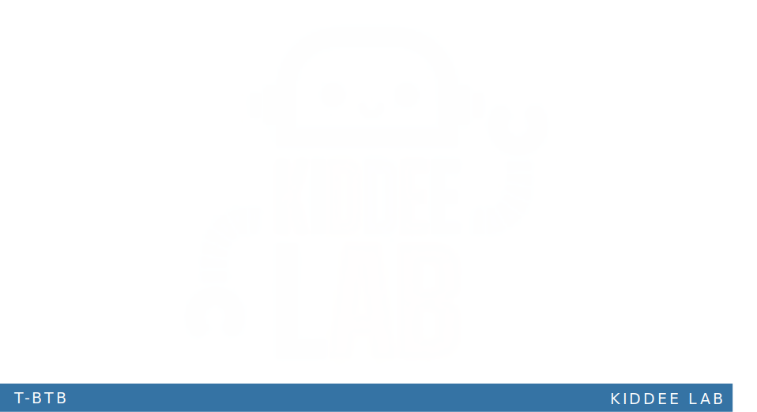

Singular Value Decomposition (SVD)

Slide 2
Singular Value Decomposition (SVD)
SVD is a a factorization technique used in linear algebra and matrix computations. SVD decomposes a matrix into three separate matrices, providing a useful way to analyze and manipulate the original matrix.
Given an m x n matrix A, SVD factorizes it as:
A = U * Σ * V^T
Where:
U is an m x m orthogonal matrix, often referred to as the left singular vectors.
Σ is an m x n diagonal matrix, with the diagonal elements containing the singular values of A.
V^T is the transpose of an n x n orthogonal matrix V, often called the right singular vectors.

Slide 3
Singular Value Decomposition (SVD)
The diagonal elements of Σ are the singular values of A, arranged in descending order. Singular values represent the importance of the corresponding singular vectors in capturing the information of the original matrix.
SVD has numerous applications in various fields, including data compression, image processing, recommender systems, and dimensionality reduction. It is widely used in linear algebra, statistics, and machine learning due to its ability to reveal the underlying structure and important features of a matrix.

Slide 4
Advantages of SVD
Dimensionality Reduction: SVD allows for dimensionality reduction by retaining only the most significant singular values and vectors. This reduction in dimension can simplify data analysis and improve computational efficiency.
Information Extraction: SVD can extract the underlying structure and important features of a matrix. It reveals hidden relationships, patterns, and trends that may not be immediately apparent in the original data.
Numerical Stability: SVD is a numerically stable decomposition method, meaning it is less prone to computational errors compared to other factorization techniques. This stability ensures reliable results even for ill-conditioned or noisy matrices.

Slide 5
Advantages of SVD
Flexibility: SVD can be applied to various types of matrices, including rectangular and sparse matrices. It is not restricted to square matrices, making it suitable for a wide range of applications.
Interpretability: The singular values and vectors obtained from SVD have intuitive interpretations. The singular values represent the importance or contribution of each singular vector to the original matrix, allowing for meaningful analysis and interpretation of the results.

Slide 6
Disadvantages of SVD
Computational Complexity: SVD can be computationally expensive, especially for large matrices. The time and memory requirements for performing SVD increase with the size of the matrix, making it less efficient for very large-scale problems.
Storage Requirements: SVD requires storing the entire matrix U, Σ, and V^T, which can be memory-intensive, particularly for large matrices. This can be a limitation in memory-constrained environments.
Lack of Scalability: SVD may not scale well for big data applications due to its computational complexity and storage requirements. Alternative techniques, such as randomized SVD or incremental SVD, are often used to address scalability issues.

Slide 7
Disadvantages of SVD
Loss of Localized Information: In dimensionality reduction using SVD, less significant singular values and vectors are discarded. This can result in some loss of localized information, potentially affecting the reconstruction or accuracy of the original data.
Interpretability Challenges: While the singular values and vectors have interpretability, they may not always correspond to meaningful features in the context of specific applications. Interpreting the results of SVD requires domain knowledge and careful analysis.

Slide 8
Application with SVD
Data Compression
Image Processing
Recommender Systems
Dimensionality Reduction
Latent Semantic Analysis (LSA)
Signal Processing

